Slide 1
SEARCH ALGORITHMS

Slide 2
Searching
Searching is a step by step procedure to solve a search-problem in a given search space. A search problem can have three main factors
State Space: State space represents the set of all possible states which a system may have.
Start State: It is a state from where agent begins the search.
Goal test: It is a function which observe the current state and returns whether the goal state is achieved or not.

Slide 3
Searching
The Solution to a search problem is a sequence of actions
The sequence of actions is called plan, which transform the start state to goal state.
This plan is achieved through the search algorithms.

Slide 4
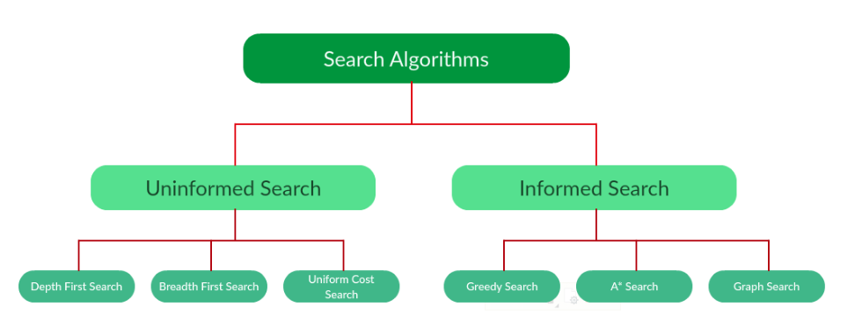
Types of search

Slide 5
Uninformed search vs Informed search
Uninformed Search : algorithms have no additional information on the goal node other than the one provided in the problem definition.
Uninformed search is also called Blind search.
Informed search: algorithms have information on the goal state, which helps in more efficient searching.
This information is obtained by something called a heuristic.

Slide 6
Depth First Search
Depth-first search (DFS) is an algorithm for traversing or searching tree or graph data structures.
The algorithm starts at the root node and explores as far as possible along each branch before backtracking.
“deepest node first” strategy
It is implemented using a stack.

Slide 7
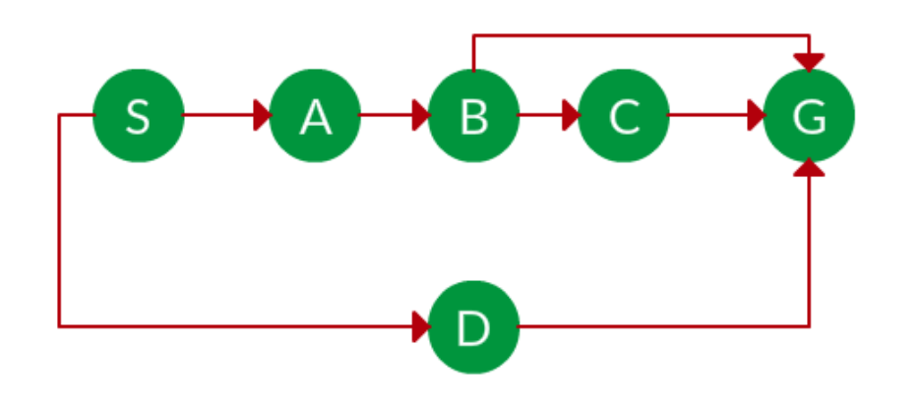
Find the DFS traversal?

Slide 8
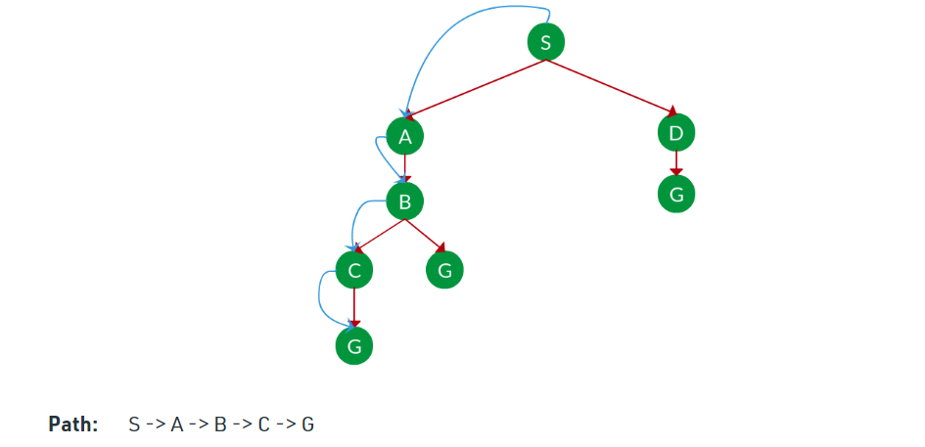
DFS

Slide 9
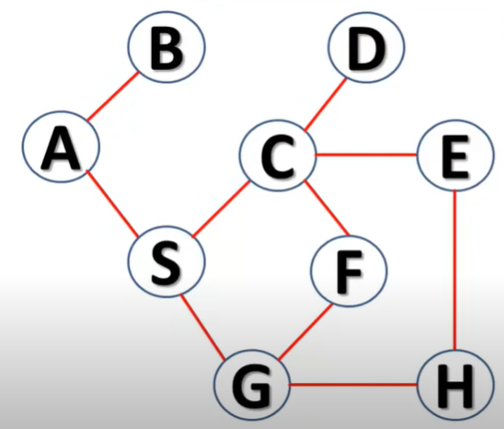
Solve using DFS

Slide 10
Solution
A B S C D E H G F

Slide 11
BFS
Breadth-first search (BFS) is an algorithm for traversing or searching tree or graph data structures.
It starts at the tree root and explores all of the neighbor nodes at the present depth prior to moving on to the nodes at the next depth level.
“shallowest node first” strategy.
It is implemented using a queue.

Slide 12
BFS
The BFS will visit the node and mark it as visited and places it in the queue.
Now the BFS will visit the nearest and un-visited nodes and marks them. These values are also added to the queue.
The queue works on the FIFO model.
In a similar manner, the remaining nearest and un-visited nodes on the graph are analyzed marked and added to the queue.
These items are deleted from the queue as receive and printed as the result.

Slide 13
Find the BFS traversal?

Slide 14
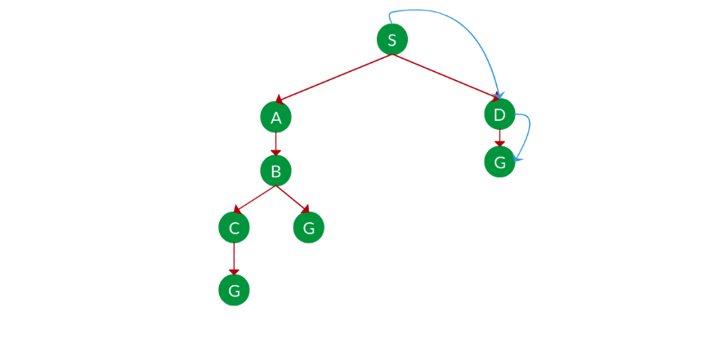
BFS

Slide 15
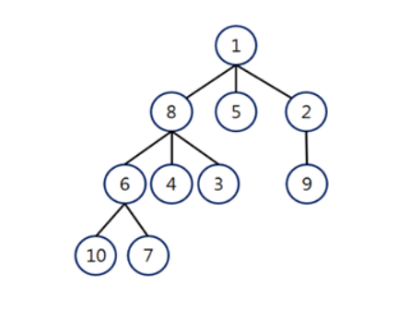
Solve using BFS

Slide 16
Solution
1 8 5 2 6 4 3 9 10 7

Slide 17
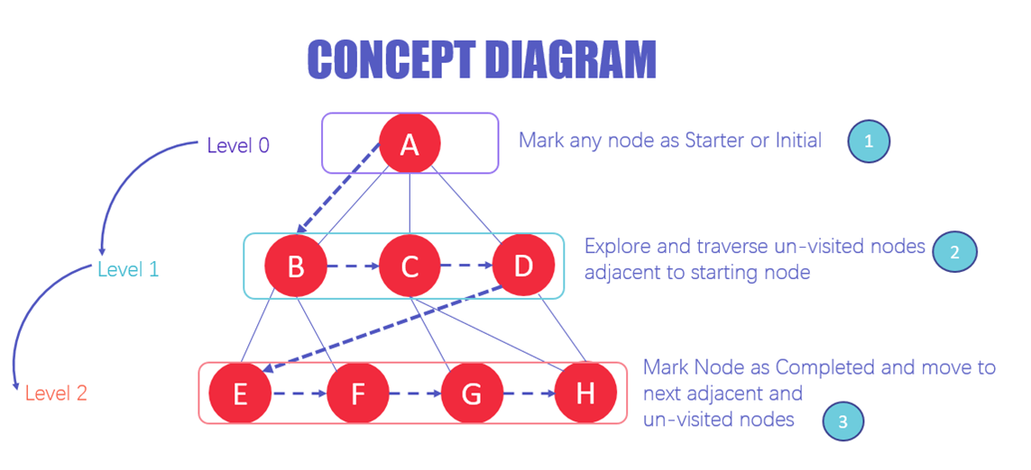
BFS Architecture

Slide 18
Why do we need BFS Algorithm?
BFS is useful for analyzing the nodes in a graph and constructing the shortest path of traversing through these.
BFS can traverse through a graph in the smallest number of iterations.
The architecture of the BFS algorithm is simple and robust.
The result of the BFS algorithm holds a high level of accuracy in comparison to other algorithms.
BFS iterations are seamless, and there is no possibility of this algorithm getting caught up in an infinite loop problem.

Slide 19
Uniform Cost Search
UCS is different from BFS and DFS because here the costs come into play.
The goal is to find a path where the cumulative sum of costs is the least.
The cost of each node is the cumulative cost of reaching that node from the root.
Based on the UCS strategy, the path with the least cumulative cost is chosen.

Slide 20
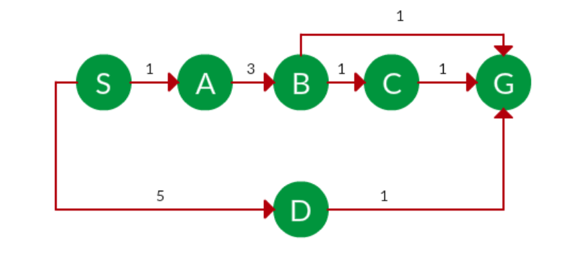
Find the UCS traversal?

Slide 21
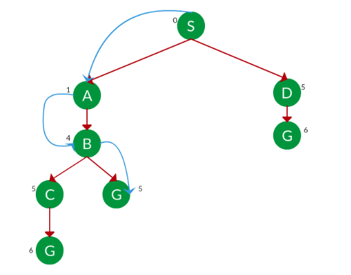
UCS

Slide 22
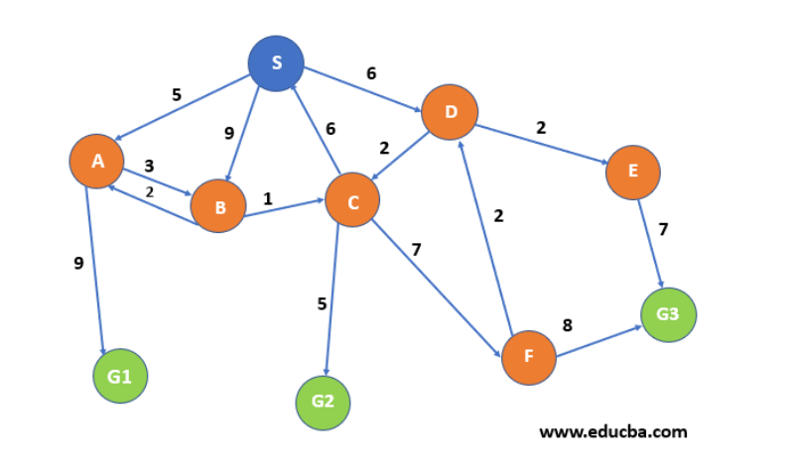
Solve using UCS

Slide 23
Solution
–S->D->C->G2

Slide 24
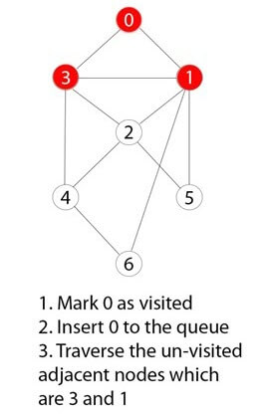
Example BFS Algorithm
You have a graph of seven numbers ranging from 0 – 6.
STEP 1

Slide 25
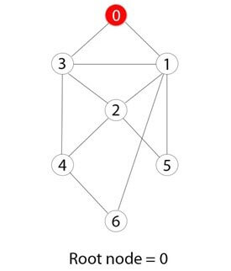
STEP 2
0 or zero has been marked as a root node.

Slide 26
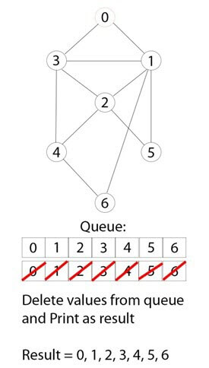
STEP 3
0 is visited, marked, and inserted into the queue data structure.

Slide 27
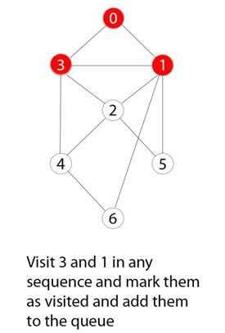
STEP 4
Remaining 0 adjacent and unvisited nodes are visited, marked, and inserted into the queue.

Slide 28
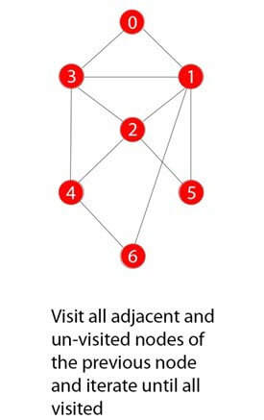
STEP 5
Traversing iterations are repeated until all nodes are visited.

Slide 29
Rules of BFS Algorithm
A queue (FIFO-First in First Out) data structure is used by BFS.
You mark any node in the graph as root and start traversing the data from it.
BFS traverses all the nodes in the graph and keeps dropping them as completed.
BFS visits an adjacent unvisited node, marks it as done, and inserts it into a queue.

Slide 30
(Contd..)
Removes the previous vertex from the queue in case no adjacent vertex is found.
BFS algorithm iterates until all the vertices in the graph are successfully traversed and marked as completed.
There are no loops caused by BFS during the traversing of data from any node.

Slide 31
Applications of BFS Algorithm
Un-weighted Graphs: BFS algorithm can easily create the shortest path and a minimum spanning tree to visit all the vertices of the graph in the shortest time possible with high accuracy.
P2P Networks: BFS can be implemented to locate all the nearest or neighbouring nodes in a peer to peer network. This will find the required data faster.

Slide 32
(Contd..)
Web Crawlers: Search engines or web crawlers can easily build multiple levels of indexes by employing BFS. BFS implementation starts from the source, which is the web page, and then it visits all the links from that source.
Navigation Systems: BFS can help find all the neighbouring locations from the main or source location.
Network Broadcasting: A broadcasted packet is guided by the BFS algorithm to find and reach all the nodes it has the address for.

Slide 33
Iterative deepening search
To avoid the infinite depth problem of DFS,
only search until depth L,
i.e., we don’t expand nodes beyond depth L.
→ Depth-Limited Search
What if solution is deeper than L? → Increase L iteratively.
→ Iterative Deepening Search
This inherits the memory advantage of Depth-first search
Better in terms of space complexity than Breadth-first search.

Slide 34
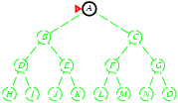
Iterative deepening search
Initial state = A

Slide 35
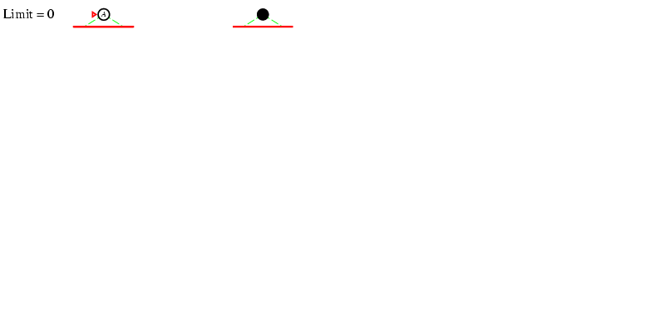
Iterative deepening search L=0

Slide 36
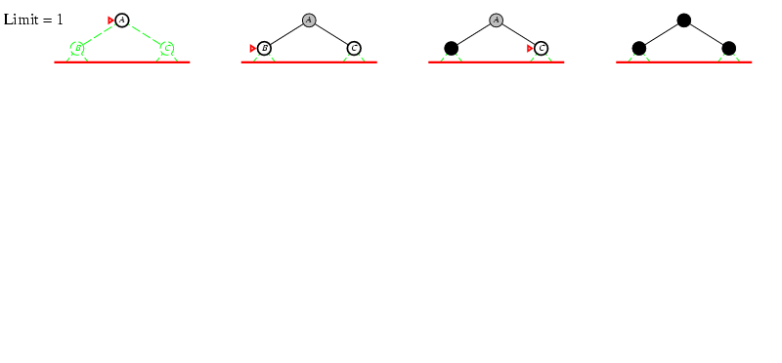
Iterative deepening search L=1

Slide 37
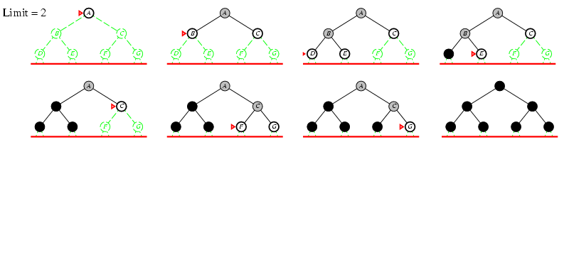
Iterative deepening search L=2

Slide 38
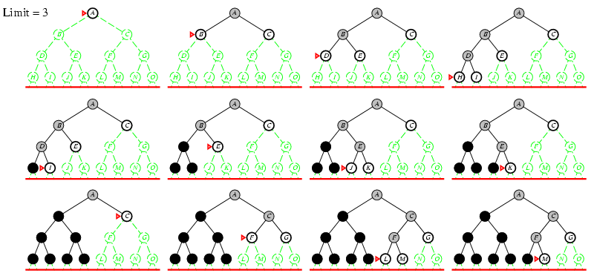
Iterative Deepening Search L=3

Slide 39
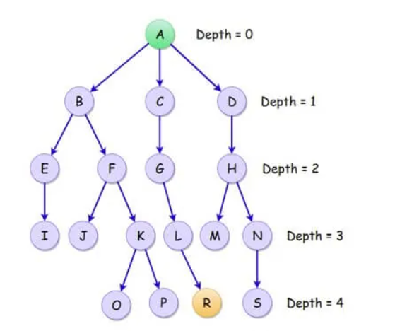
Solve using IDS

Slide 40
Properties of iterative deepening search
Complete? Yes
Time? O(b^{d})
Space? O(bd)
Optimal? No, for general cost functions.
Yes, if cost is a non-decreasing function only of depth.

Slide 41
Depth Limited Search
DFS with predetermined limit
Advantage
Memory efficient
Disadvantage
Incompleteness
May not be optimal, if more than one solution

Slide 42
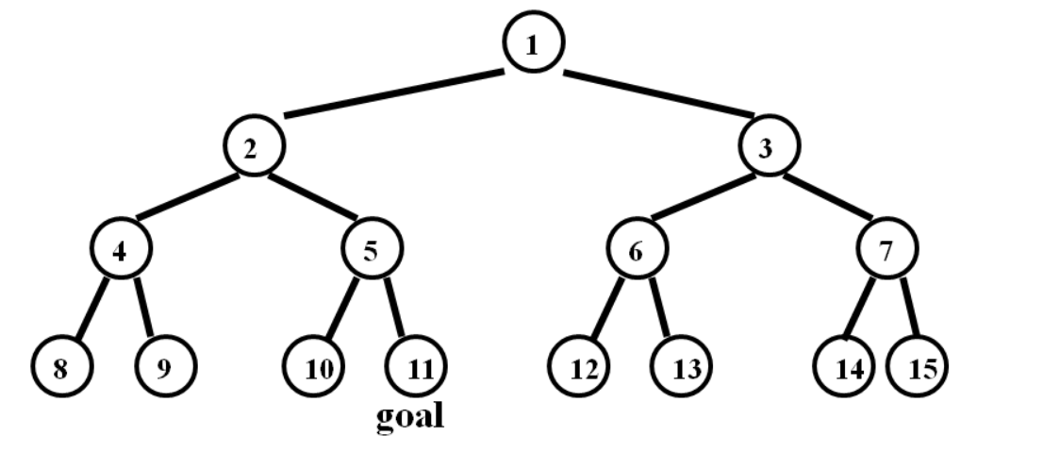
Solve using DLS

Slide 43
DLS (depth limit 3): 1, 2, 4, 5, 3, 6, 7

Slide 44
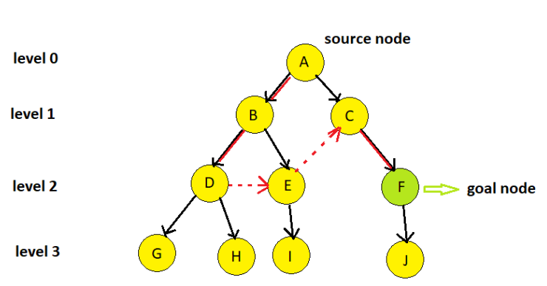
Solve using DLS

Slide 45
Depth limit =2
A->B->D->E->C->F

Slide 46
Iterative deepening search
Number of nodes generated in a depth-limited search to depth d with branching factor b:
N_{DLS} = b⁰ + b¹ + b² + … + b^{d-2} + b^{d-1} + b^{d}
Number of nodes generated in an iterative deepening search to depth d with branching factor b:
N_{IDS} = (d+1)b⁰ + d b¹ + (d-1)b² + … + 3b^{d-2} +2b^{d-1} + 1b^{d}
= O(b^{d})
For b = 10, d = 5,
N_{DLS} = 1 + 10 + 100 + 1,000 + 10,000 + 100,000 = 111,111
N_{IDS} = 6 + 50 + 400 + 3,000 + 20,000 + 100,000 = 123,450

Slide 47
THANK YOU

